Slide 1

Big Data
Notes:
1

Slide 2
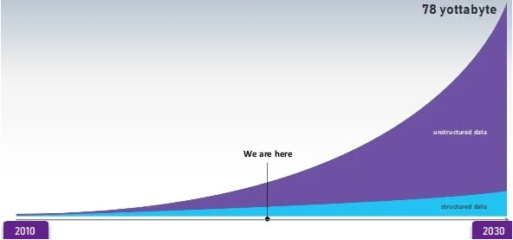
Introduction
Data that is always increasing and cannot be processed and stored on a single machine is termed as Big Data.
Notes:
2

Slide 3
Motivation
Big Data has given the organization a new way to analyze and visualize their data effectively.
For example:
Business: Customer Feedback, trends etc.
Health: Health care organizations are leveraging big data technology to capture all the information about a patient to get more complete view for insight into care coordination, health management & outcome.
Notes:
3

Slide 4
Applications
Tracking Customer Spending Habit, Shopping Behavior: In big retails store (like Amazon, Walmart, Big Bazar etc.) management team has to keep data of customer’s spending habit shopping behavior, customer’s most liked product (so that they can keep those products in the store).
Recommendation: By tracking customer spending habit, shopping behavior, Big retails store provide a recommendation to the customer. E-commerce site like Amazon, Walmart, Flipkart does product recommendation.
Education Sector: Online educational course conducting organization utilize big data to search candidate, interested in that course. If someone searches for YouTube tutorial video on a subject, then online or offline course provider organization on that subject send ad online to that person about their course.
Notes:
4

Slide 5
Challenges
Lack of knowledge Professionals
Lack of proper understanding of Massive Data
Data Growth Issues
Integrating Data from a Spread of Sources
Securing Data
Notes:
5

Slide 6
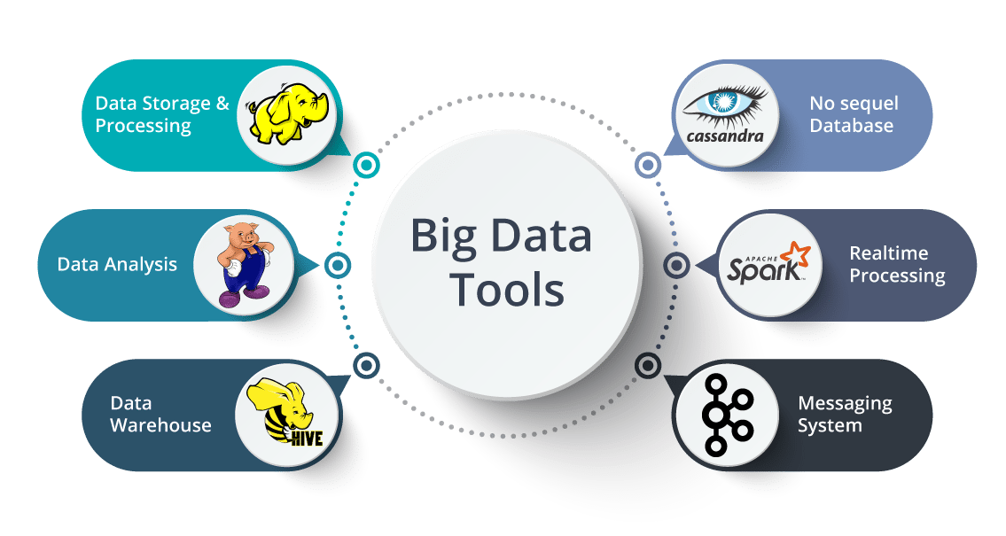
Tools and techniques
Notes:
6

Slide 7
Employ and utilize
Organizations can use big data analytics systems and software to make data-driven decisions that can improve business-related outcomes.
The benefits may include more effective marketing, new revenue opportunities, customer personalization and improved operational efficiency.
With an effective strategy, these benefits can provide competitive advantages over rivals.
Notes:
7

Slide 8
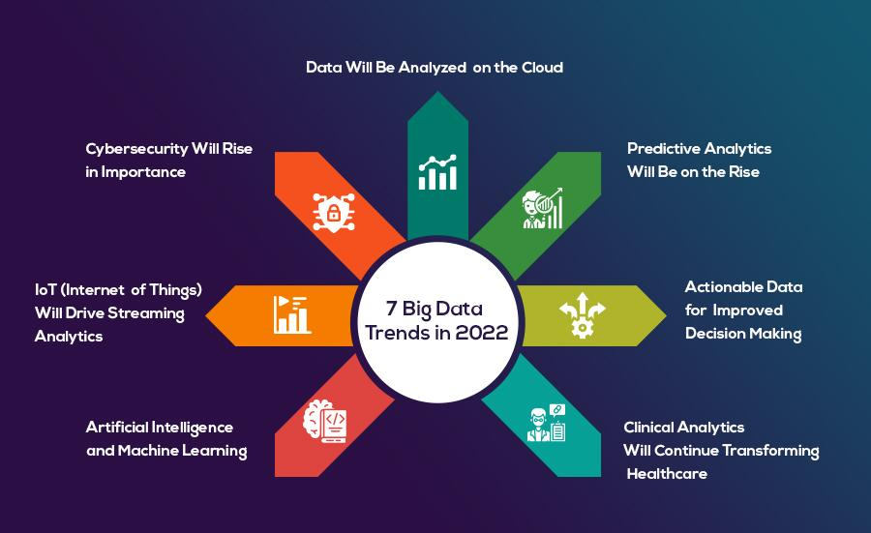
Current trends and opportunities
Notes:
8

Slide 9
Job roles
Business Analyst
Data Analyst
Data Scientist
Data Engineer/Data Architect
Machine Learning Engineer
Big Data Engineer
Notes:
9

Slide 10
Skill Set
Analytical Skills
Data Visualization Skills
Problem Solving Skills
SQL – Structured Query Language
Skills of Programming - Python, Java, R
Notes:
10

